Slide 2
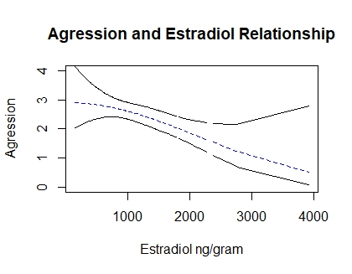
n=218 reproductive assessments,
between 3 males and 2 females
Strong negative relationship between aggression and estradiol levels
Notes:
Estimate Std. Error Z value Pr(>|z|)
(Intercept) 6.8267921 0.0046483, 1468.66 <2e-16 ***
mal_agr , -0.0142585 0.0013634 -10.46 <2e-16 ***
I(fe_estug^2), 0.1365144 0.0007585 179.98 <2e-16 ***

